Slide 1
影片敘述之自動生成 Video caption generation
吳克駿、江昶翰

Slide 2
Outline
Using larger dimensional, training with higher
epochs
Evaluate with BLEU scores
Add attention layer

Slide 3
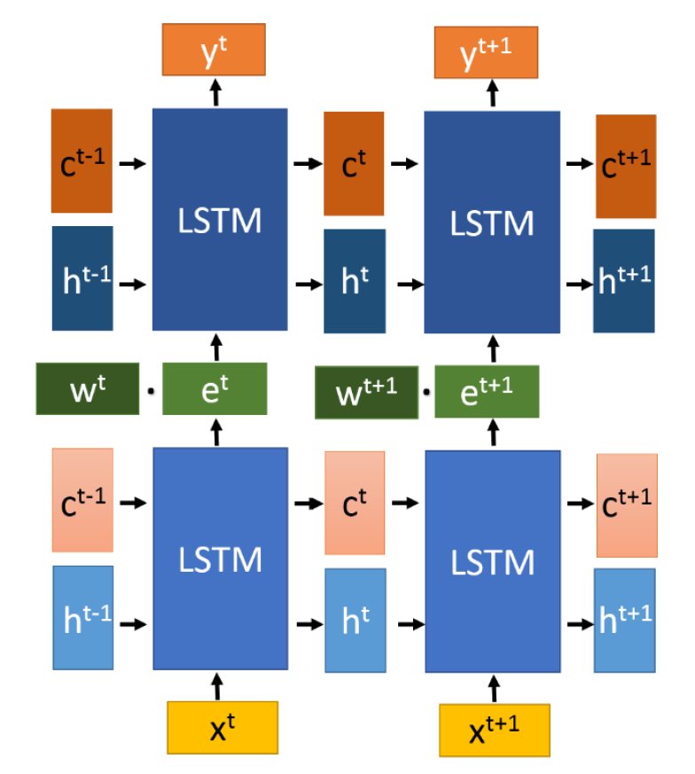
Weight matrix(128,20) Bias(20)
Using softmax-cross-entropy
LSTM2(output words)
[Encoding]
input the information of LSTM1 only
[Decoding]
input the word embedding and LSTM1’s info
output info for predicting
Hidden Layer
concatenate word embedding and output of LSTM1
LSTM1(input frames)
[Encoding]
input latent vector of image
[Decoding]
input padding
output information based on memory
Weight matrix(4096,128) Bias(128d)
Input:image features(4096d)

Slide 4
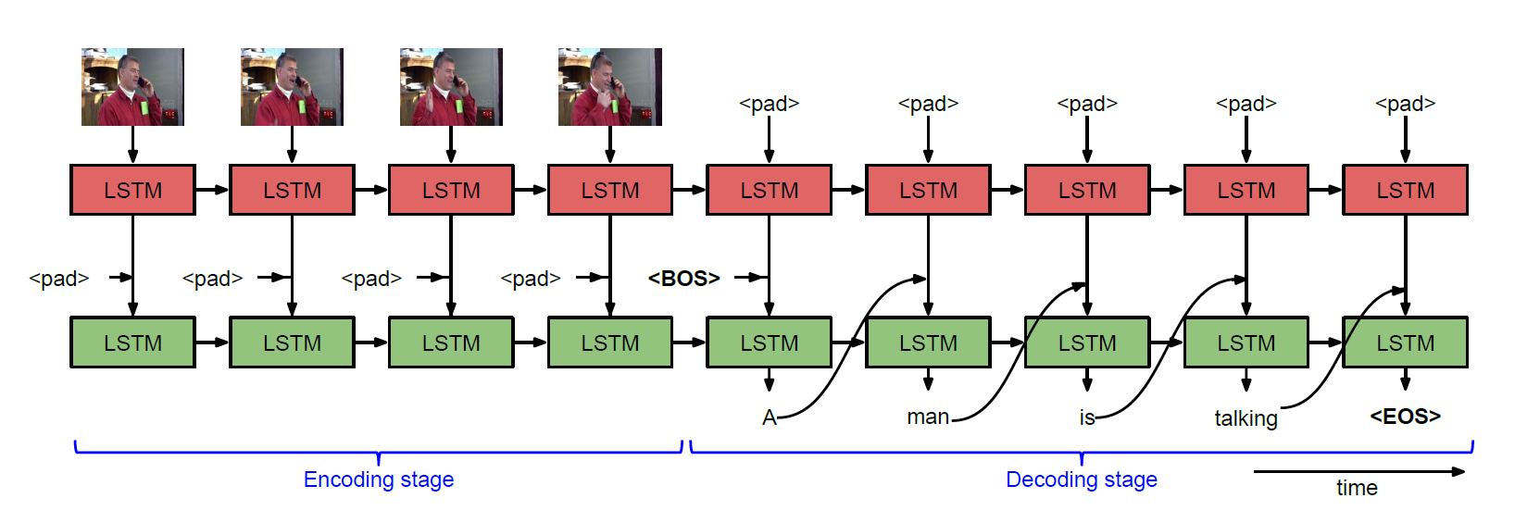
Weight matrix(128,20) Bias(20)
Using softmax-cross-entropy
LSTM2(output words)
[Encoding]
input the information of LSTM1 only
[Decoding]
input the word embedding and LSTM1’s info
output info for predicting
Hidden Layer
concatenate word embedding and output of LSTM1
LSTM1(input frames)
[Encoding]
input latent vector of image
[Decoding]
input padding
output information based on memory
Weight matrix(4096,128) Bias(128d)
Input:image features(4096d)

Slide 5
Evaluating by BLEU score
EPOCHS | Average BLEU score | TOP 3 BLEU score
100 | 0.275 | 0.450
200 | 0.232 | 0.365
300 | 0.227 | 0.354
400 | 0.227 | 0.344
500 | 0.216 | 0.334
Baseline:Average Bleu Score 0.250

Slide 6
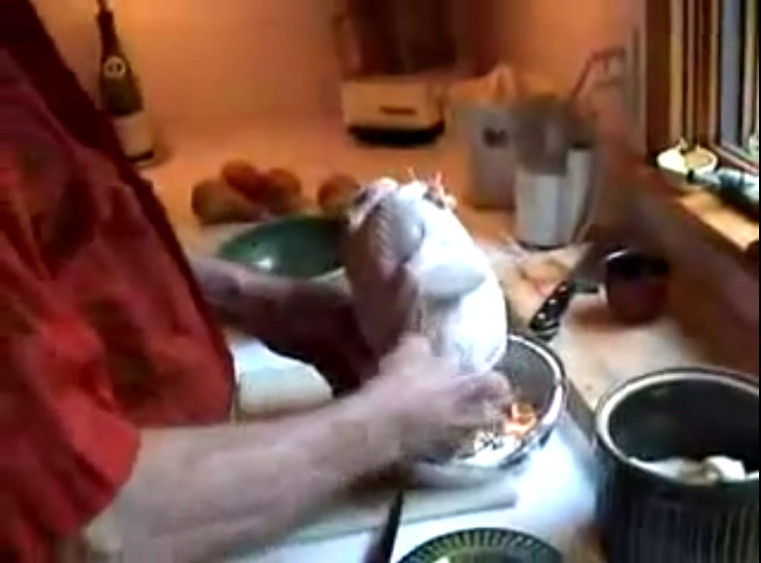
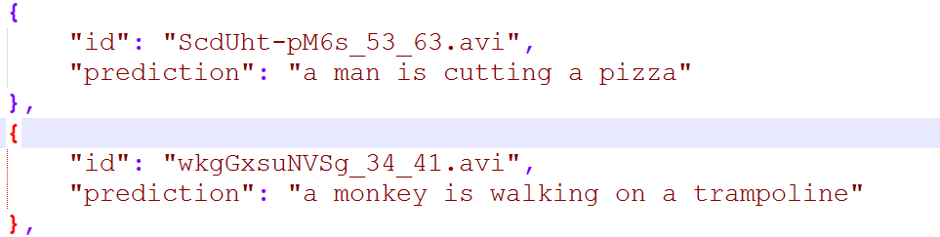
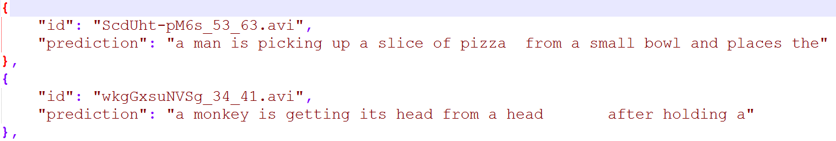
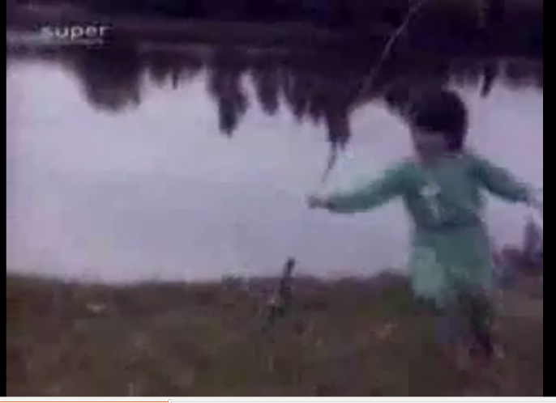
But prediction….
With 100 epochs
With 500 epochs

Slide 7
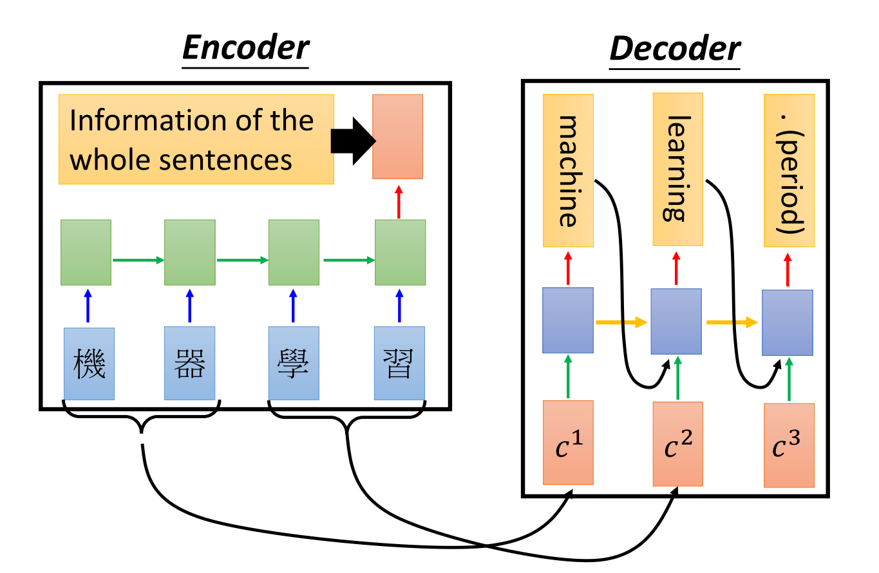
Adding attention layer

Slide 8
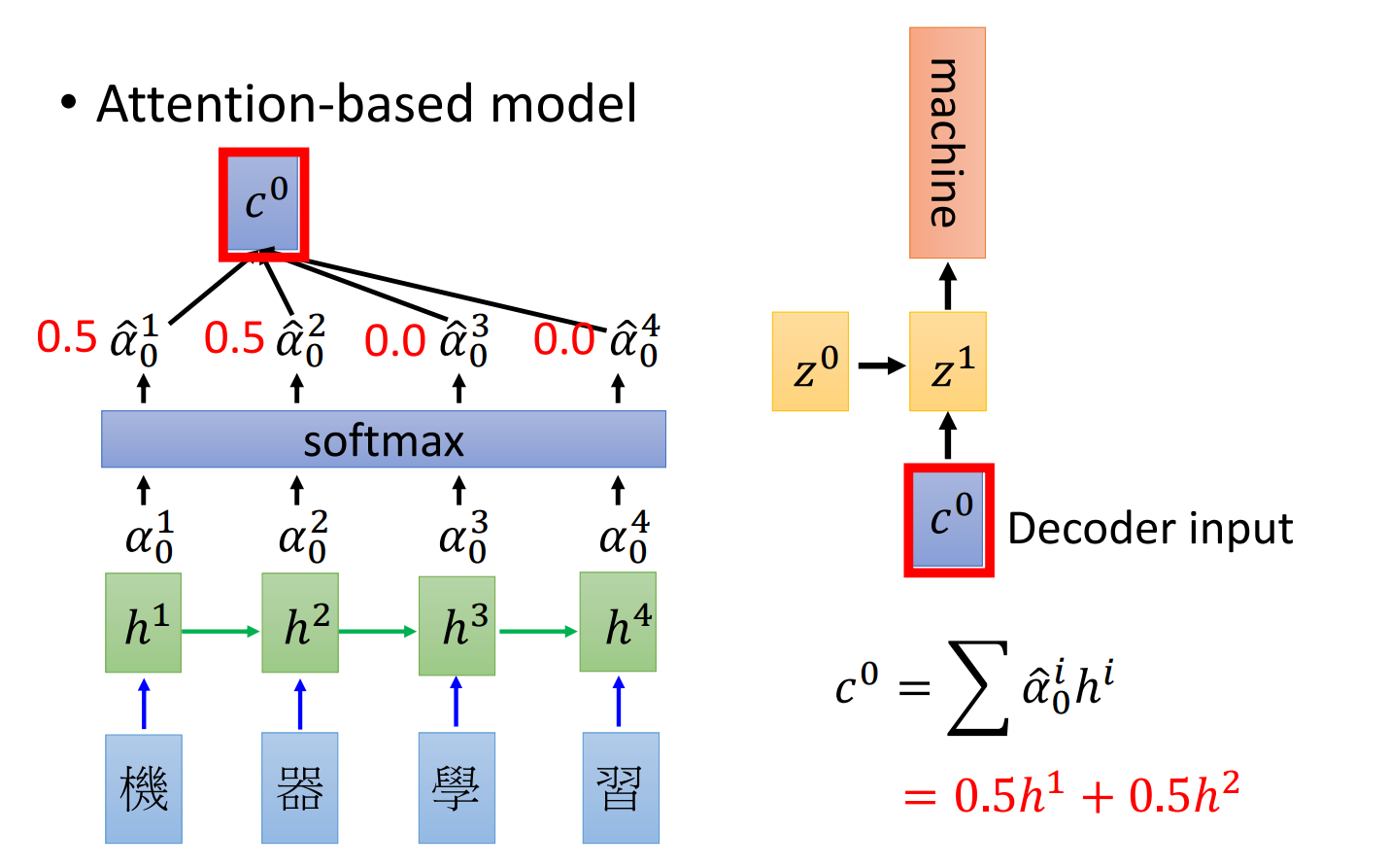
Adding attention layer

Slide 9
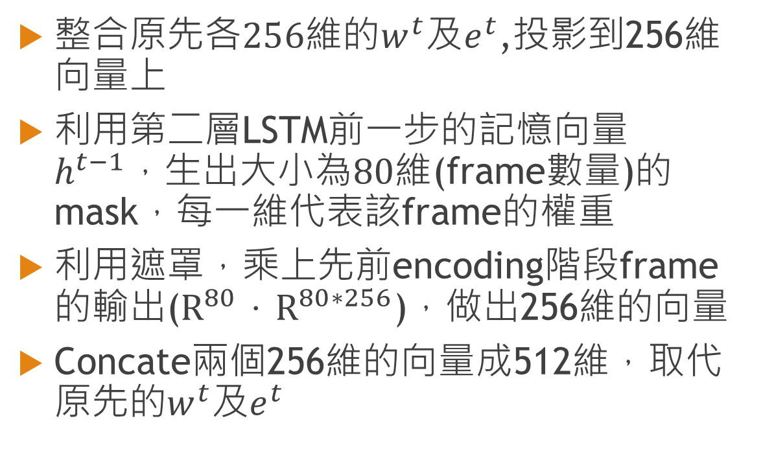
Attention layer Idea…
整合原$先各256維的w^{t}及e^{t}$,投影到256維向量上
利用第二層LSTM前一步的記憶向量$h^{t−1}，生出大小為80維$(frame數量)的mask，每一維代表該frame的權重
利用遮罩，乘上先前encoding階段frame的輸出($R^{80}．R^{80∗256}$)，做出256維的向量
Concate兩個256維的向量成512維，取代原先的$w^{t}及e^{t}$

Slide 10
Evaluating by BLEU score
EPOCHS | With attention layer | Without att layer
100 | 0.266 | 0.275
200 | 0.253 | 0.232
300 | 0.228 | 0.227
400 | 0.242 | 0.227
500 | --- | 0.216
Baseline:Average Bleu Score 0.250

Slide 11
Next step
1.Improve attention layer performance
2.bi-direction LSTM
3.Attention-based multimodal fusion

Slide 12
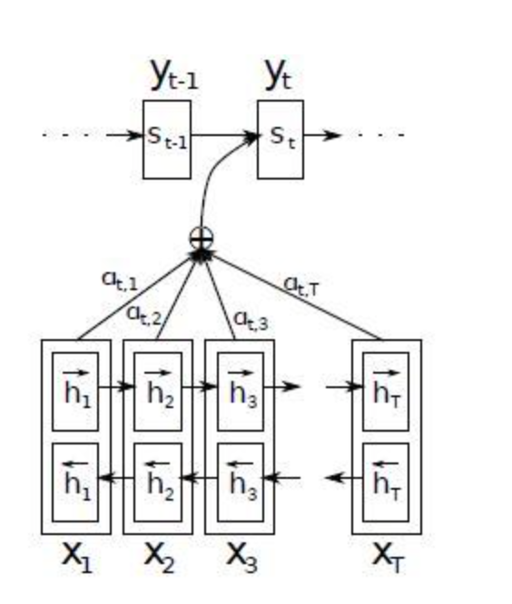
bi-direction LSTM

Slide 13
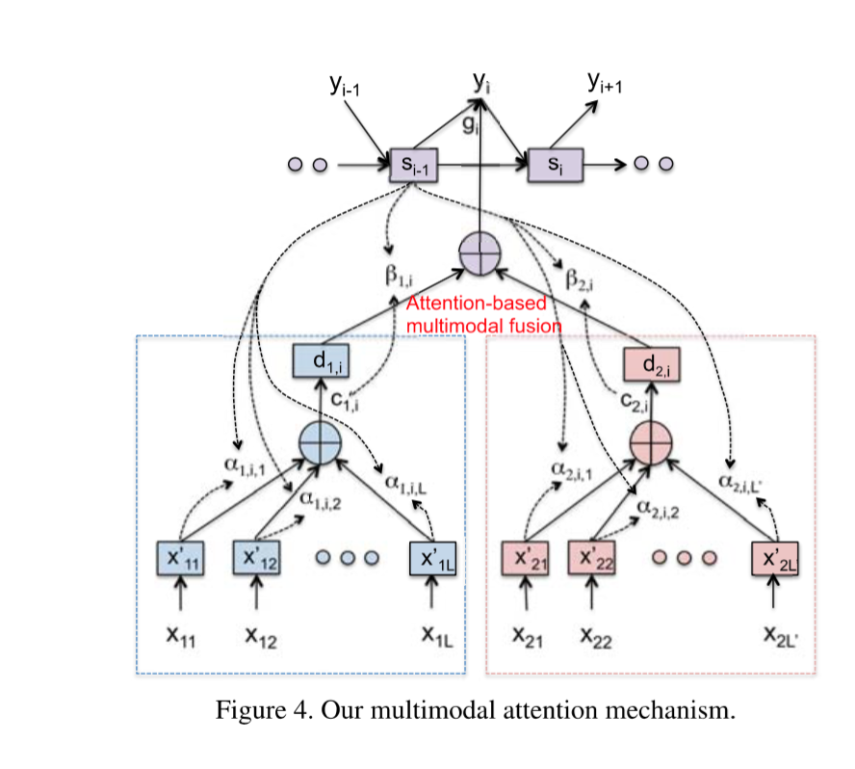
Attention-based multimodal fusion

